Slide 1
Bleeding Risk Estimation and the New (BARC) Definition of Bleeding Events
Franz Weidinger
2. Medical Department (Cardiology)
Hospital Rudolfstiftung
Vienna, Austria
SOLACI ´12, Mexico City, Interventional Pharmacology 2, Thursday 15:15/16:45 2. Room Chapultepec

Slide 2
Relevance of bleeding as a clinical endpoint
Availability of potent antithrombotic therapy including
ASA
P2Y₁₂ inhibitors (clopidogrel, prasugrel, ticagrelor)
heparin
GP IIb/IIIa inhibitors
direct thrombin inhibitors
has led to a reduction in ischemic events
but is associated with an increased risk of bleeding
the increase in bleeding is associated with worse clinical outcome

Slide 3
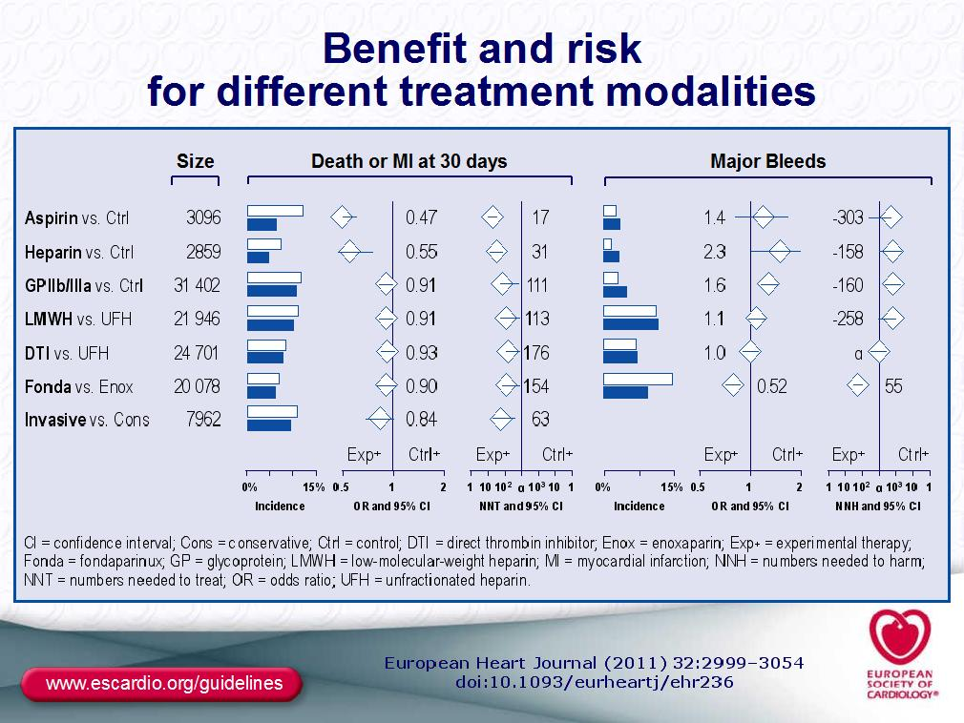
All antithrombotic agents (except fondaparinux, bivalirudin) are
associated with increased bleeding risk
Aspirin and heparin reduce death/ MI at 30 days in NSTE-ACS

Slide 4
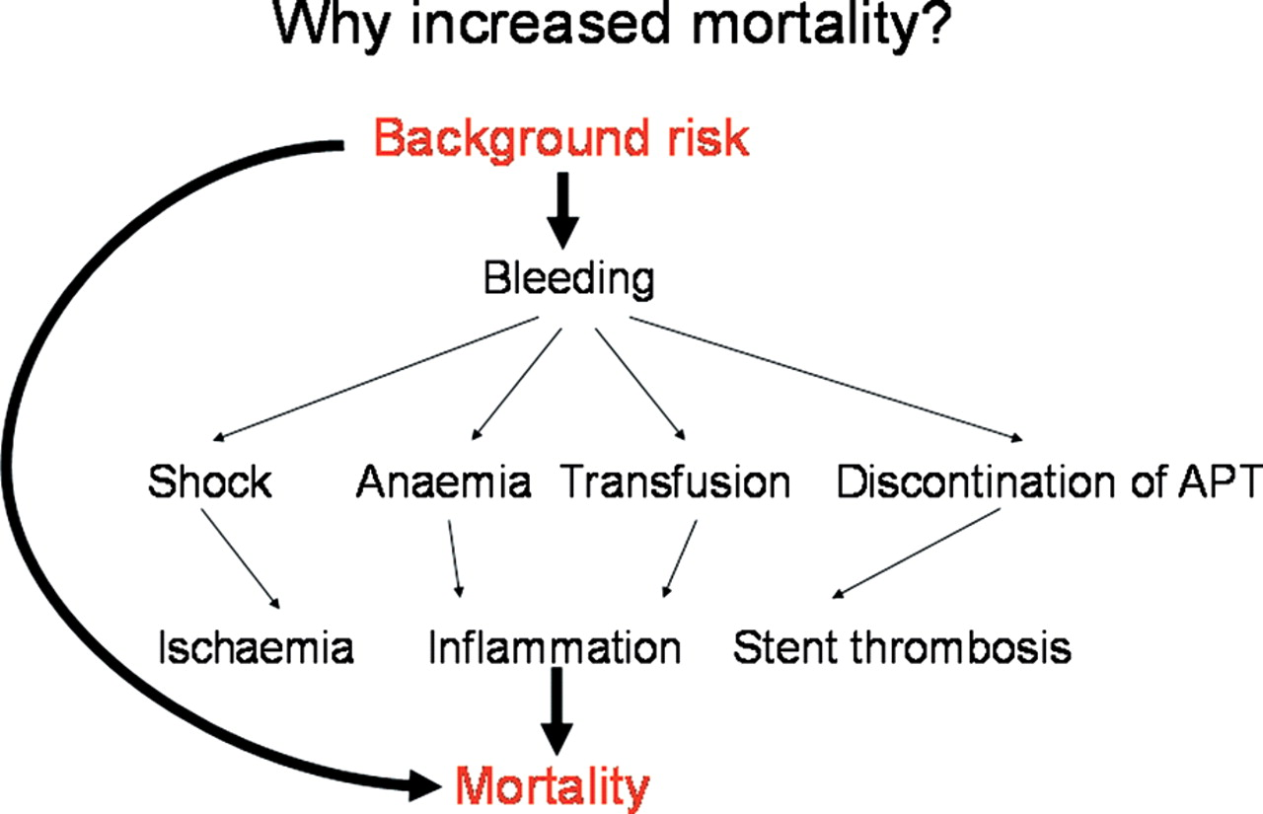
Hypothetical mechanisms linking bleeding and mortality
Steg P G et al. Eur Heart J 2011;32:1854-1864
Notes:
Schematic representations of the hypothetical mechanisms linking bleeding and mortality.

Slide 5
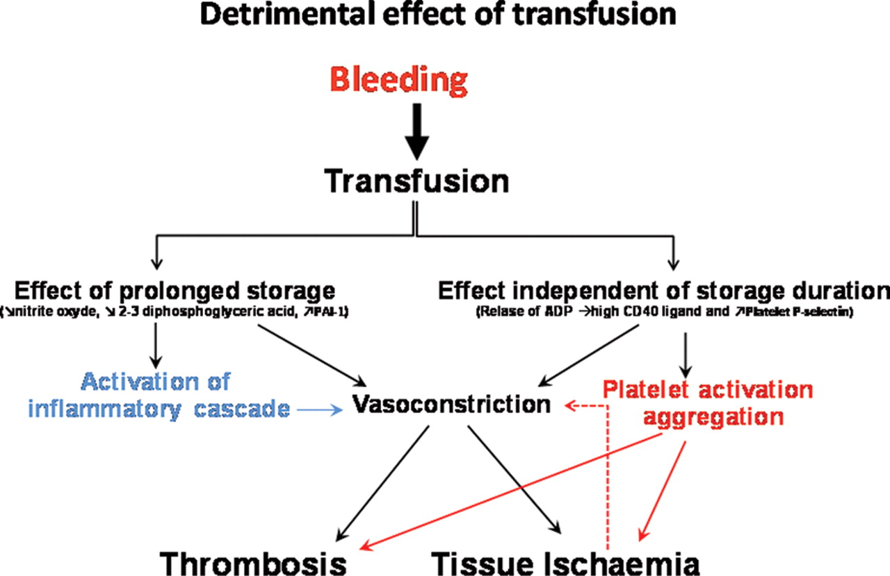
Steg P G et al. Eur Heart J 2011;32:1854-1864
Notes:
Potential mechanisms of the detrimental effect of blood transfusion.

Slide 6
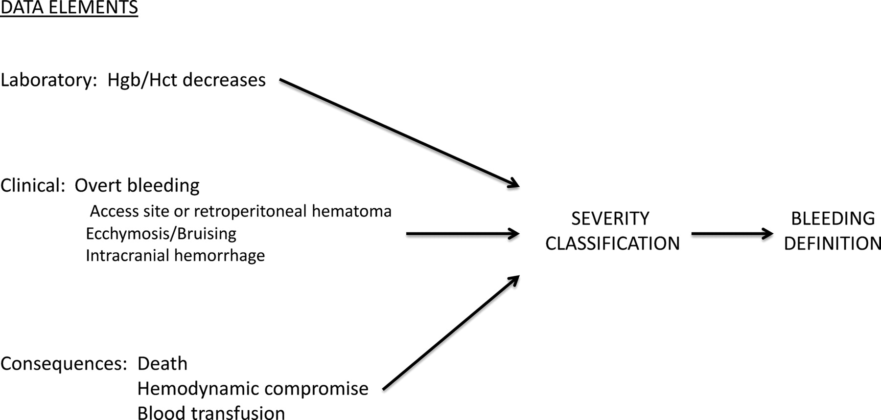
Construction of bleeding definitions using different categories of data elements
Rao & Mehran, Circulation 2012;125:1344-1346
Notes:
Construction of bleeding definitions using different categories of data elements. Hgb indicates hemoglobin; Hct, hematocrit.

Slide 7
Existing bleeding scores
TIMI Laboratory-based (hemoglobin, hematocrit decrease)
GUSTO Clinical (severity)-based
GRACE Simplified laboratory and clinical
CURE Major/ minor (combined clin. + lab)
ACUITY Major (intracranial/-ocular, access-site, retroperit.), lab
REPLACE-2
ISAR-REACT 3
PLATO
STEEPLE
CURRENT-OASIS
Thrombolysis/
conservative
PCI-based

Slide 8
Rationale for a new bleeding definition
Increased importance of bleeding as prognostic factor
Need for assessment of bleeding in RCTs and registries
Lack of comparability
Need for standardized definitions to avoid erroneous
conclusions
regarding safety of a given agent
regarding superiority of one agent over another

Slide 9
BARC (Bleeding Academic Research Consortium) definitions, Mehran et al, Circulation 2011;123:2736-2747
Type 0: no evidence of bleeding
Type 1: bleeding that is not actionable, without need for hospitalization or treatment (e.g. bruising, hematoma, nosebleeds, etc.)
Type 2: any clinically overt sign of hemorrhage that is actionable but does not meet criteria for type 3, 4 or 5. Must meet at least 1 of following criteria:
Requires intervention
Leads to hospitalization
Prompts evaluation

Slide 10
BARC (Bleeding Academic Research Consortium) definitions, Mehran et al, Circulation 2011;123:2736-2747
Type 3: clinical, laboratory, and/or imaging evidence of bleeding, with healthcare provider responses:
BARC type 3a:
any transfusion with overt bleeding
overt bleeding plus hemoglobin drop ≥3 to <5 g/dL
BARC type 3b:
overt bleeding plus hemoglobin drop >5 g/dL
Cardiac tamponade
Bleeding requiring surgical intervention for control
(excluding dental/nasal/skin/hemorrhoid)
Bleeding requiring intravenous vasoactive drugs
BARC type 3c:
Intracranial hemorrhage, subcategories confirmed by autopsy, imaging or lumbar puncture
Intraocular bleed compromising vision

Slide 11
BARC (Bleeding Academic Research Consortium) definitions, Mehran et al, Circulation 2011;123:2736-2747
Type 4: Coronary Artery Bypass Graft–related bleeding
Perioperative intracranial bleeding within 48 hours
Reoperation after closure of sternotomy for the purpose
of controlling bleeding
Transfusion of ≥5 U whole blood or packed red
blood cells within a 48-hour period
Chest tube output 2 L within a 24-hour period
Notes: If a CABG-related bleed is not adjudicated as at least a type 3 severity event, it will be classified as not a bleeding event. If a bleeding event occurs with a clear temporal relationship to CABG (ie, within a 48-hour time frame) but does not meet type 4 severity criteria, it will be classified as not a bleeding event.
Type 5: Fatal bleeding

Slide 12
Type 5 – fatal bleeding
Probable fatal bleeding (type 5a)
bleeding that is clinically suspicious as the cause of death, but the bleeding is not directly observed and there is no autopsy or confirmatory imaging.
Definite fatal bleeding (type 5b)
bleeding that is directly observed (by either clinical specimen [blood, emesis, stool, etc] or imaging) or confirmed on autopsy
BARC fatal bleeding is meant to capture deaths
that are directly due to bleeding with no other cause. The time interval from the bleeding event to the death should be considered with respect to likely causality, but there is no specific time limit proposed.

Slide 13
Type 2 bleeding - further explanations
Requires intervention:
defined as a healthcare professional– guided medical treatment or percutaneous intervention to stop or treat bleeding, including temporarily or permanently discontinuing a medication or study drug
Examples include coiling, compression, use of reversal agents (Vit. K, protamine), local injections to reduce oozing, or a temporary/permanent cessation of antiplatelet, antithrombin, or fibrinolytic therapy

Slide 14
Type 2 bleeding - further explanations
Leads to hospitalization or an increased level of care:
defined as leading to or prolonging hospitalization or transfer to a hospital unit capable of providing a higher level of care
Prompts evaluation:
defined as leading to an unscheduled visit to a healthcare professional resulting in diagnostic testing (laboratory or imaging). Examples include, but are not limited to, hematocrit testing, hemoccult testing, endoscopy, colonoscopy, computed tomography scanning, or urinalysis.

Slide 15
Open questions regarding BARC
Why 48-hour window for CABG-related bleeding?
Why type 1 „not actionable“ when patient may „take action“ such as discontinuing medication (with potentially serious consequences such as ST)?
Why consider intraocular bleed equivalent to intracranial bleed for BARC 3c?
Type 1 bleed subject to misinterpretation by the patient
Hicks et al (editorial), Circulation 2011;123:2664

Slide 16
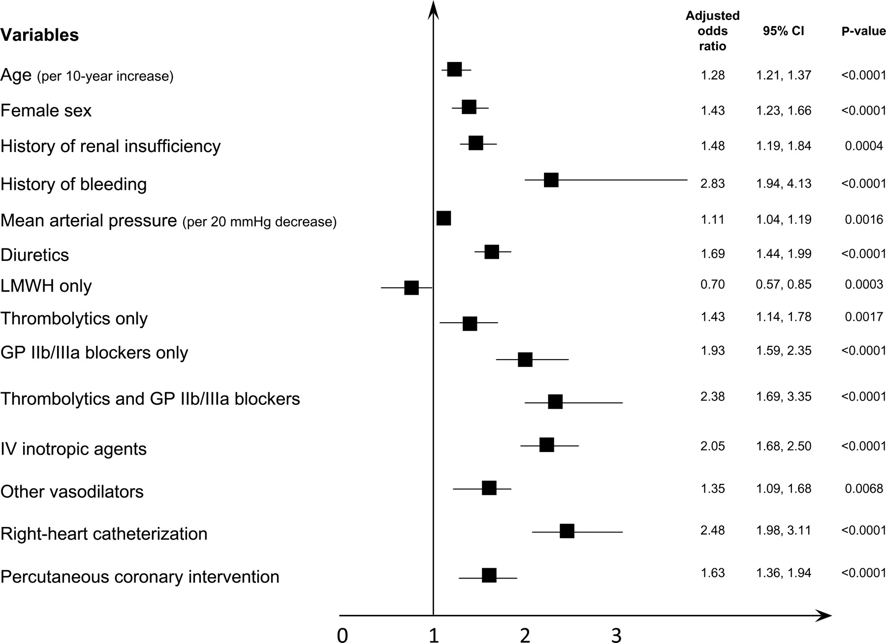
Predictors of bleeding in acute coronary syndrome
Age, female sex, renal insufficiency, history of bleeding, use of invasive
procedures, lower body weight are powerful predictors of bleeding in ACS
Steg P G et al. Eur Heart J 2011;32:1854-1864
Notes:
Predictors of bleeding in acute coronary syndrome. Adapted from Moscucci et al., GRACE.9 Referent groups male sex: UFH for LMWH only, both LMWH and UFH, and neither LMWH nor UFH, neither thrombolytics nor GP IIb/IIIa blockers for thrombolytics only, GP IIb/IIIa blockers only, and both thrombolytics and GP IIb/IIIa blockers; no for other variables. Hosmer–Lemeshow goodness-of-fit test P-value = 0.59, C-statistic = 0.75. GP, glycoprotein; LMWH, low-molecular-weight heparin; UFH, unfractionated heparin.

Slide 17
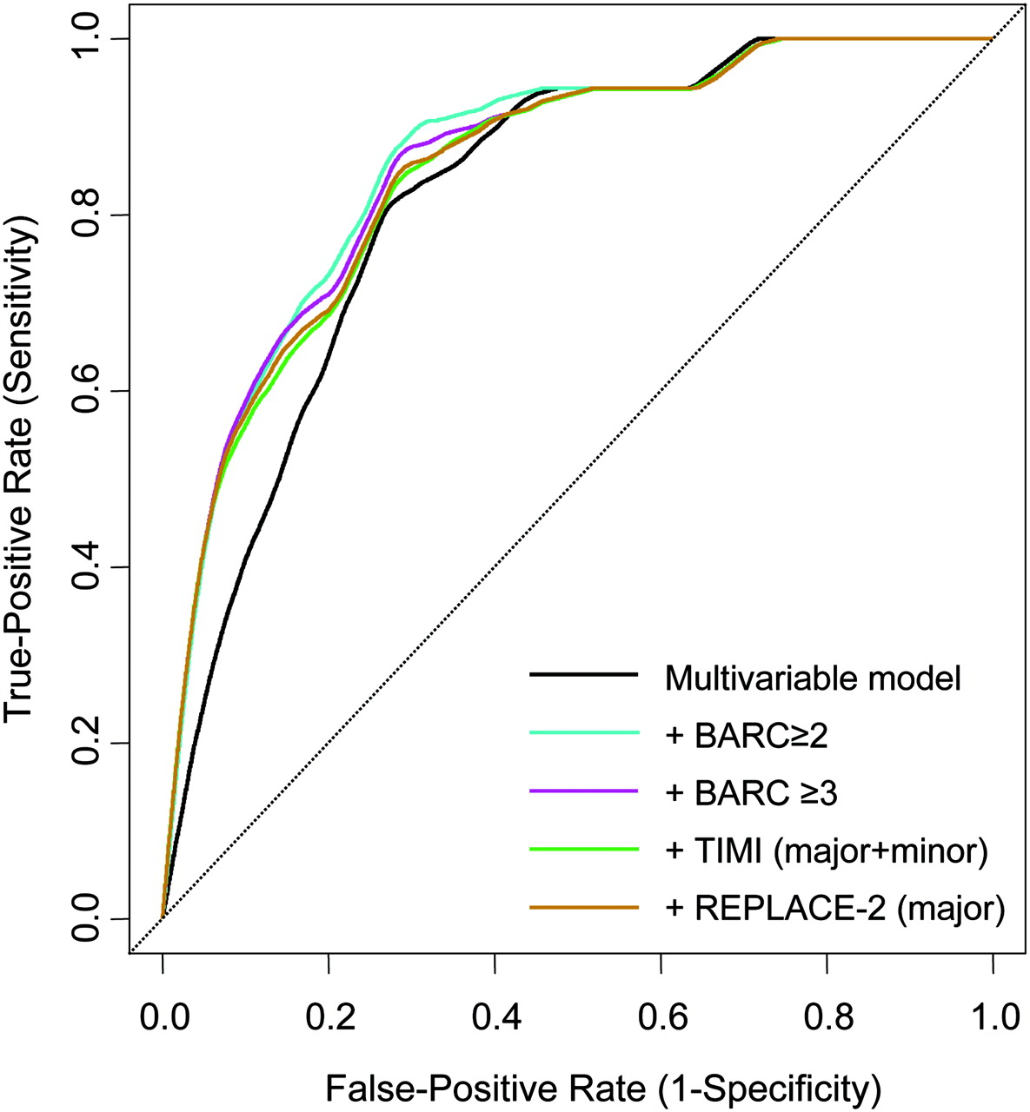
Validation of the BARC bleeding definitions in patients with CAD undergoing PCI
(pooled analysis of 12,459 pts of 6 RCTs)
Comparison of bleeding definitions:
BARC
TIMI
REPLACE-2
Bleeding confirmed as independent
predictor of death
All 3 definition criteria improved
prediction
Comparable predictivity of all 3
definitions with respect to 1-year
mortality
Ndrepepa G et al., Circulation 2012;125:1424-1431
Notes:
Adjusted receiver operating characteristic curves showing predictivity of the multivariable models in regard to 1-year mortality without and with inclusion of the bleeding events defined by Bleeding Academic Research Consortium (BARC), Thrombolysis in Myocardial Infarction (TIMI), and Randomized Evaluation in PCI Linking Angiomax to Reduced Clinical Events (REPLACE-2) criteria.

Slide 18
Conclusion
BARC is a new objective, hierarchically graded classification of bleeding
(Mehran, Circulation [June 14] 2011:123:2736)
BARC is based on consensus rather than data-driven
Prospective validation is warranted
across the spectrum of IHD
across management strategies (conservative, invasive)
in the context of all invasive procedures (PCI, CABG, endovascular, TAVI)

Slide 19
Conclusion (2)
Final validation of BARC and proof of its utility depend on
its use by all future RCTs as common safety endpoint
unanimous assessment procedure (questionnaires)
More important than using one or the other bleeding risk score is the agreement and commitment among clinical trialists to use the same score for comparability of data!

Slide 20
Thank you !

